Slide 1
Bridge Pattern

Slide 2
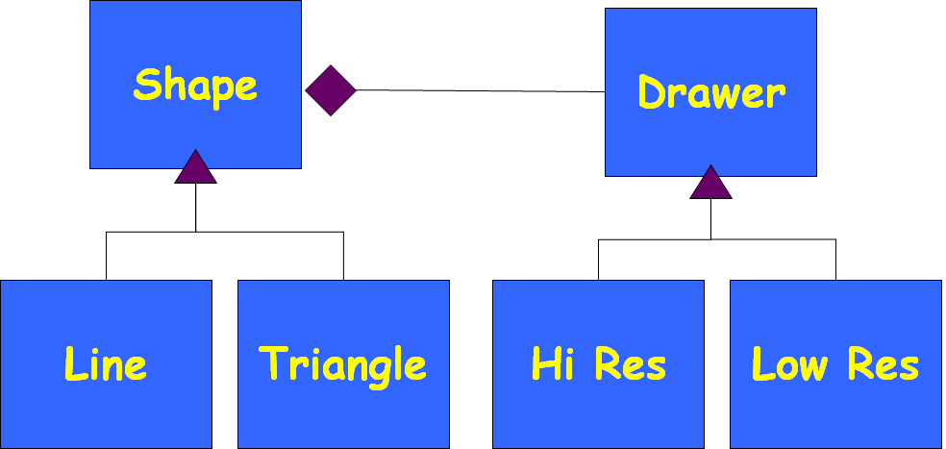
Bridge Pattern: Introduction
Helps decouple an abstraction hierarchy from its implementation:
  So that implementations and abstractions can vary independently.
  Allows using one of several implementations of an interface to be decided upon dynamically.

Slide 3
Bridge Pattern
Also known as a Handle/Body pattern.
  Split a class design into two class hierarchies.
  One represents the concepts (called the handle).
  The other embodies the implementation, and is called the body.
  Handle forwards any invocations to the body.

Slide 4
Motivation: Novice Conference Participant Class Design
Conference
Participant
Organiser
Special
Guest
Registrant
Tutorial
Presenter
Paper
Presenter
Organiser
Tutorial
Presenter
Student
Paper
Presenter
Industrial
Academic
Student

Slide 5
Solution: Delegate to Roles
For the discussed example, multiple inheritance is not a good solution.
Delegation to required roles is a much better solution --- makes the solution more flexible.
Conference
Member
performs
1..*
Conference
Role
Organiser
Special
Guest
Registrant
Tutorial
Presenter
Paper
Presenter
Industrial
Academic
Student

Slide 6
Motivating Example 2
You designed a graphics package…
shape
Circle
draw()
area();
Line
draw()
area()
Rectangle
draw()
area();

Slide 7
Motivating Example cont…
Things worked fine:
  Until you had to support mobile phones that can draw only low precision shapes.
  You extended your design….
shape
Line
Rectangle
LineLow
LineHigh
RectLow
RectHigh

Slide 8
Motivating Example cont…
You soon had to support a different way of drawing for efficient transient views for animation…
  You extended your design again ….
shape
Line
Rectangle
LineLow
LineHigh
RectLow
RectHigh
LineLowN
LineLowT
RecHighN
RecHighT

Slide 9
You soon needed a different way of drawing on Smartphones…
Things were becoming pretty complicated …
until you decided to use bridge design pattern…
defines the interface
shapes to draw
Shape
Drawer
Line
Triangle
Hi Res
Low Res
Bridge Design Pattern
“adapters” for specific
drawing interfaces

Slide 10
Separate the abstraction from implementation
defines the interface
shapes to draw
Abstraction
Implementation
Shape
Drawer
Line
Triangle
Hi Res
Low Res
Bridge Design Pattern
“adapters” for specific
drawing interfaces

Slide 11
Exercise 1
Consider thread scheduling :
Thread Scheduler
Preemptive Thread Scheduler
Time sliced Thread Scheduler
Unix PTS
Windows PTS
Unix TSTS
Windows TSTS

Slide 12
Exercise 1
We need to now support Java platform also…
Explosive Class Hierarchy!
Thread Scheduler
Give bridge solution!
Preemptive Thread Scheduler
Time sliced Thread Scheduler
Unix PTS
Windows PTS
Unix TSTS
Windows TSTS
JVM PTS
JVM TSTS

Slide 13
Solution with Bridge Pattern
Refactor into two orthogonal hierarchies:
  Platform-independent abstractions and platform dependent implementations
Thread Scheduler
ThreadSched-Impl
Unix
Windows
Preemptive Thread Scheduler
Time sliced Thread Scheduler
JVM

Slide 14
Few Observations…
Suppose an abstraction has several implementations:
  Inheritance is commonly used to accommodate these!!!
But inheritance binds an implementation to the abstraction permanently:
  It becomes difficult to modify and reuse abstraction and implementations independently.
Inheritance without a Bridge:.
  Leads to violation of single responsibilty principle

Slide 15
Overusing of inheritance…
“As a beginning object-oriented analyst, I had a tendency to solve every kind of problem by using special cases, taking advantage of inheritance. I loved the idea of inheritance because it seemed new and powerful. I used it whenever I could. This usually seems to be normal to many beginning analysts, but it is naive: “given a new hammer, everything seems like a nail.”

Slide 16
Bridge: Applicability
Use bridge Pattern when:
You want to avoid a permanent binding between an abstraction and its implementation.
  Implementation may be selected or switched at run time.
Both the abstraction and their implementation should be extensible by subclassing without impacting the clients:
  Even client code would not need recompiling.

Slide 17
Bridge: Structure
Client
<<abstract>>
Abstraction
+ Operation()
<<interface>>
Implementor
+ Implementation()
RefinedAbstraction1
+ Operation()
RefinedAbstraction2
+ Operation()
ConcreteImplementorA
+ Implementation()
ConcreteImplementorB
+ Implementation()

Slide 18
Why the Name Bridge?
Shape
Drawer
Line
Triangle
Hi Res
Low Res
Taxonomy in
Application Domain
Taxonomy in
Solution Domain

Slide 19
Provides A Bridge Between the Application and Solution domains…
Shape
Drawer
Line
Triangle
Hi Res
Low Res
Taxonomy in
Application Domain
Taxonomy in
Solution Domain

Slide 20
Bridge Pattern: Exercise 1
How do we improve this design?
Vehicle
Ford
Toyota
Sporty
Truck
SUV
SportyFord
ToyotaTruck
FordTruck
SportyToyota
FordSUV
Existing design…

Slide 21

Exercise 1: Solution…
Use Bridge when you might otherwise be tempted to use multiple inheritance...
Car
CarManufacturer
Sporty
Truck
Ford
Toyota

Slide 22
When should we apply Bridge Pattern?
We want run-time binding with any required implementation.
We need to overcome a proliferation of classes:
  Resulted from a coupled interface and numerous implementations
  We need to map these into orthogonal class hierarchies…

Slide 23
Benefits
Decoupling abstraction from implementation
Reduction in number of sub-classes
Reduction of program complexity and executable code size.
Interface and Implementation can be varied independently.
Improved extensibility:
  Abstraction and Implementation can be extended independently…

Slide 24
Drawbacks?
Runtime inefficiency
Increased Complexity due to double Indirection :
  Abstraction→ Implementor →ConcreteImplementor

Slide 25
Final Analysis
Application of the time tested principle:
  “Find what varies and encapsulate it” and
  “Favor object composition over class inheritance”

Slide 26
Decorator Pattern

Slide 27
Decorator Pattern
Intent:
  Attach additional responsibilities to an object dynamically.
  Provides a flexible alternative to subclassing.
A wrapper pattern!
Motivation:
  Add responsibilities to individual objects as and when required and not to an entire class
  Should conform to the interface of the object being decorated.

Slide 28
Decorator: In Simple Words
You have an object:
  You wrap it with another object.
  They both support the same interface.
  Later possibly wrap with more objects..
  The ones on outside are "decorators"
Clients use the one on the outermost.
  Each decorator either masks, changes, or passes on method calls to one inside it…
Obj

Slide 29
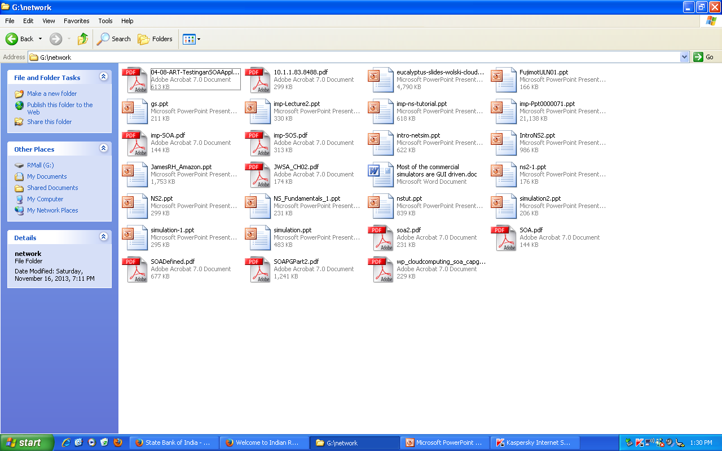
You were working with a directory listing window… then you decided to resize it…

Slide 30
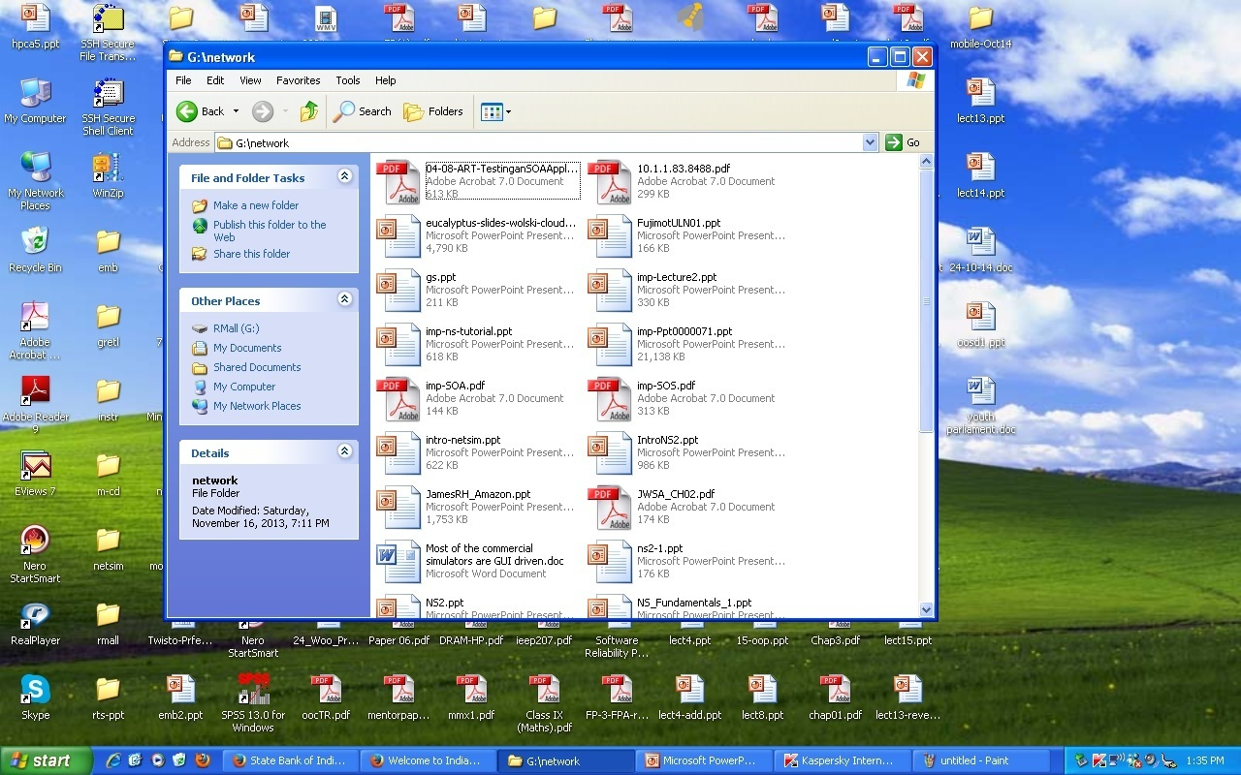
A scroll bar has appeared!!!
How can a window change?

Slide 31
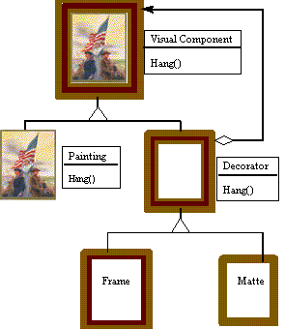

A Non-Software Example
Frames are often added to pictures.
Prior to hanging, the paintings may be matted
Matte

Slide 32
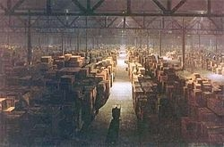
Matte Painting? --Digression
Helps create the illusion of an environment that is nonexistent or is too expensive or impossible to build or visit.
The government warehouse in Raiders of the Lost Ark (1981) was painted on glass by Michael Pangrazio at Industrial Light & Magic, and combined with live-action footage of a government worker, pushing his cargo up the center aisle.

Slide 33

A Matte Painting

Slide 34


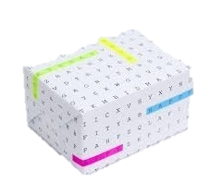
Decorator: Non-software example 2
Suppose you would like to give a gift to someone:.
- First you select the gift…
- Next you wrap the gift…
The gift can be wrapped in several ways…

Slide 35
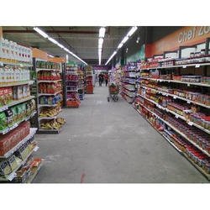
Gift-Wrap Options
Various options for wrapping gift:
box wrapped with gift-paper
box wrapped with gift-paper-with-crepe-paper
box wrapped with gift-paper-with-bow-without-crepe-paper
box wrapped with gift-paper-with-bow and crepe-paper
box wrapped with gift-paper with bow and crepe-paper and card
box wrapped with gift-paper with bow and crepe-paper without card
box wrapped with gift-paper without bow with crepe-paper and card
box wrapped with gift-paper without bow with crepe-paper without card
And so on…
Gift Paper
Kraft Paper
Crepe Paper
Bow
Card
Bow
Bow
Card
Card
Card
Card
Gift-wraps

Slide 36
Solution
To overcome the problem, manufacturers sell the following materials separately:
  Boxes
  Gift Papers
  Cards
  Bows
  Crepe-paper
Clients select any number of materials and ask them to be put in any order required!

Slide 37
Decorator Pattern: Some Examples…
Add borders or scrollbars to a GUI component
Add headers and footers to an advertisement
Add functionality to a stream :
  Reading input line by line or word by word; or compress a file before sending it over.

Slide 38
Decorator: Some General Concepts
A Decorator adds responsibilities to individual objects (not to all objects of a class!) dynamically:
  In situations where a large number of independent extensions required…
  An explosion of subclasses would occur if every combination to be supported.
  Difficult to understand, remember and apply…

Slide 39
Decorator: Recounting the Ideas
A Decorator is an object that has an interface identical to an object that it contains.
  Used for adding additional functionality to a particular object at run time as opposed to adding to a class.
  Any call that the decorator gets, it relays to the object that it contains, and adds its own functionality along the way, either before or after the call.
Obj

Slide 40
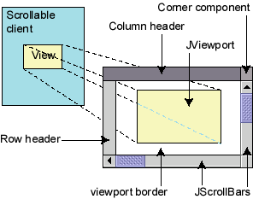
Decorator example: GUI
Normal GUI components don't have scroll bars
JScrollPane is a container with scroll bars to which you can add any component to make it scrollable
// JScrollPane decorates GUI components
JTextArea area = new JTextArea(20, 30);
JScrollPane scrollPane =
new JScrollPane(area);
contentPane.add(scrollPane);

Slide 41
Decorator: Programming Example
We have a text object and …
  We want to add a border
  Sometimes we want to also add a scrollbar.
Border decorator
Scrollbar decorator
For example, we may have
a text object and we want
to sometimes add a
vertical scrollbar and
Sometimes we want to add a
horizontal scrollbar.
For example, we may have
a text object and we want
to sometimes add a
vertical scrollbar and
Sometimes we want to add a
horizontal scrollbar.
Original text object

Slide 42
Decorator: Object Diagram
Border
Scrollbar
text
decorated
decorators
The objects refer each other like a linked list or chain of objects.
The last in the list is the decorated object.

Slide 43
Widget and Stream Examples
Suppose you have a user interface toolkit and you wish to provide a choice of border or scrolling to clients.
The client "attaches" the border or scrolling to only those objects requiring these capabilities.
Widget aWidget = new BorderDecorator(
new ScrollDecorator(new TextView(), 1);
aWidget.draw();
Stream Example
  Cascading responsibilities to an output stream
  Stream aStream = new CompressingStream(
  new ASCII7Stream(new FileStream( "fileName.dat" )));
  aStream.putString( "Hello world" );

Slide 44
Example: Decorator Class Structure
VisualComponent
Draw()
TextView
Decorator
Draw()
Draw()
ScrollDecorator
BorderDecorator
Draw()
ScrollTo()
Draw()
DrawBorder()
ScrollPosition
BorderWidth

Slide 45
Decorator Structure
Client
component
1
component
operation()
Concrete component
decorator
operation()
operation()
Concrete decoratorA
Concrete decoratorB
operation()
operation()

Slide 46
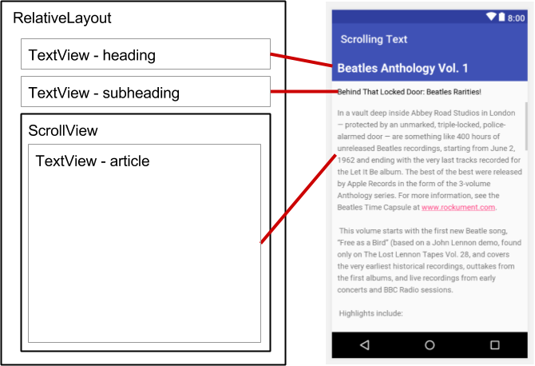
An Example Application
Consider a TextView GUI component:
  You want to add different kinds of borders and/or scrollbars to it.
You can add 3 types of borders:
  Plain, 3D, or Fancy
Also scrollbars:
  Horizontal or Vertical
An inheritance solution would require 15 classes!

Slide 47
That’s a lot of classes!
    TextView_Plain
    TextView_Fancy
    TextView_3D
    TextView_Horizontal
    TextView_Vertical
    TextView_Horizontal_Vertical
    TextView_Plain_Horizontal
    TextView_Plain_Vertical
    TextView_Plain_Horizontal_Vertical
    TextView_3D_Horizontal
    TextView_3D_Vertical
    TextView_3D_Horizontal_Vertical
    TextView_Fancy_Horizontal
    TextView_Fancy_Vertical
    TextView_Fancy_Horizontal_Vertical

Slide 48
A Simpler Solution
The component is contained in another object (decorator) that adds the border.
The decorator conforms to the interface of the component:
  So its presence is transparent to clients
The decorator forwards requests to the component:
  May perform additional actions before or after forwarding.

Slide 49
VisualComponent
draw()
resize()
1
TextView
draw()
resize()
StreamedVideoView
draw()
resize()
Decorator
draw()
resize()
1
Decorator contains a visual component
An imagined example
Border
draw()
resize()
ScrollBar
draw()
resize()
Plain
draw()
resize()
3D
draw()
resize()
Fancy
draw()
resize()
Horiz
draw()
resize()
Vert
draw()
resize()

Slide 50
Disadvantages of Inheritance
Use of inheritance leads to an explosion of classes …
With another type of border added:
  Many more classes would be needed with this design.
If another view were added such as StreamedVideoView:
  Double the number of Borders/Scrollbar classes
Use the Decorator Pattern instead!

Slide 51

Decorator Disadvantages
When tempted to add many decorators:
  A package may become hard to understand…
  Like Java I/O streams!!!
Solutions become complex:
  A factory class may help
F-<number>

Slide 52
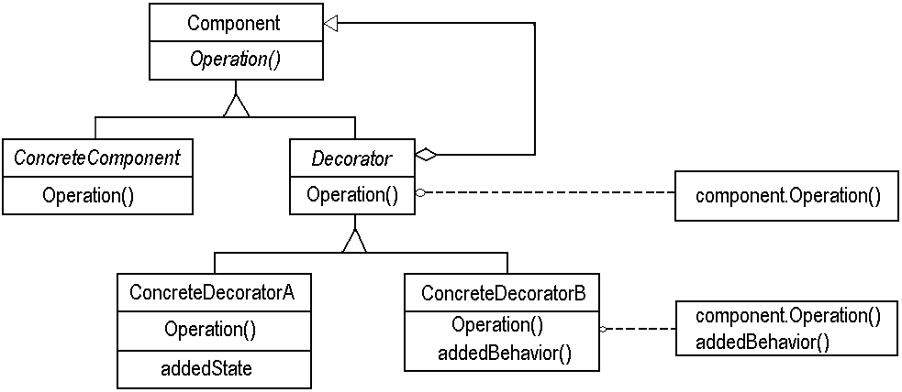
Decorator: Review
Interface for objects that can have responsibilities added to them dynamically
An object to which additional responsibilities can be attached.

Slide 53
Decorator Example: Object Diagram
aBorderDecorator
component
aScrollDecorator
component
aTextView

Slide 54
Java Borders
Any JComponent can have 1 or more borders
Borders are useful objects that, while not themselves components:
  Know how to draw the edges of Swing components…
Borders are useful not only for drawing lines and fancy edges:
  But also for providing titles and empty space around components

Slide 55
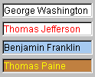

JTextField, JTextArea
An input control for typing text values
(field = single line; area = multi-line)
public JTextField(int columns)
public JTextArea(int lines, int columns)
Creates a new field, the given number of letters wide.
public String getText()
Returns the text currently in the field.
public void setText(String text)
Sets field's text to be the given string.
  What if the text area is too big to fit in the window?

Slide 56
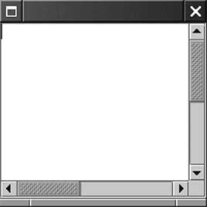
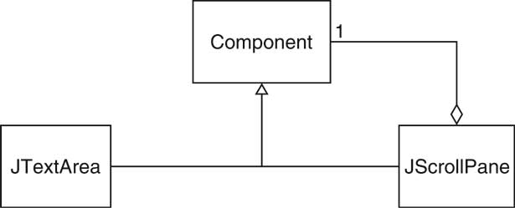
Example: Scroll Bars
Scroll bars can be attached to components
Approach #1: Component class can turn on scroll bars
Approach #2: Scroll bars can surround component
JScrollPane pane = new JScrollPane(component);
Swing uses approach #2
JScrollPane is again a component

Slide 57
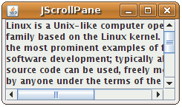
JScrollPane
A container that adds scrollbars
around any other component
public JScrollPane(Component comp)
Wraps the given component with scrollbars.
  After constructing the scroll pane, you must add the scroll pane, to the onscreen container:
  myContainer.add(new JScrollPane(textarea),
  BorderLayout.CENTER);

Slide 58
Quiz
An ice cream can be made with any of the following types of toppings in any combination and order:
  Nutty
  Honey
  Fruity
  Chocolate
  Vanilla
Draw class diagram
Write Java Code

Slide 59
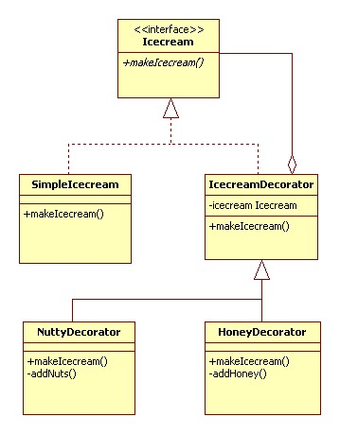
Quiz: Solution

Slide 60
Quiz: Java Code
public interface Icecream {
public String makeIcecream();
}
public class SimpleIcecream implements Icecream {
public String makeIcecream() {
return "Base Icecream";
}
abstract class IcecreamDecorator implements Icecream {
protected Icecream specialIcecream;
public IcecreamDecorator(Icecream specialIcecream) {
this.specialIcecream = specialIcecream;}
public String makeIcecream() {
return specialIcecream.makeIcecream();}
}

Slide 61
public class NuttyDecorator extends IcecreamDecorator {
public NuttyDecorator(Icecream specialIcecream) {
super(specialIcecream); }
public String makeIcecream() {
return specialIcecream.makeIcecream() + addNuts(); }
private String addNuts() {
return " + crunchy nuts“;}
}
public class HoneyDecorator extends IcecreamDecorator {
public HoneyDecorator(Icecream specialIcecream) {
super(specialIcecream); }
public String makeIcecream() {
return specialIcecream.makeIcecream() + addHoney(); }
private String addHoney() {
return " + sweet honey";}
}

Slide 62

Making Sense of Stream Classes…
What are System.in.read() , System.out.print(), etc… ?
System class contains a variable called in -- an object created from a subclass of InputStream.
  The period character after in states that read() belongs to in
In other words:
  read() is a method that belongs to an object called in, which in turn belongs to a class called System.
public final class System extends Object;

Slide 63

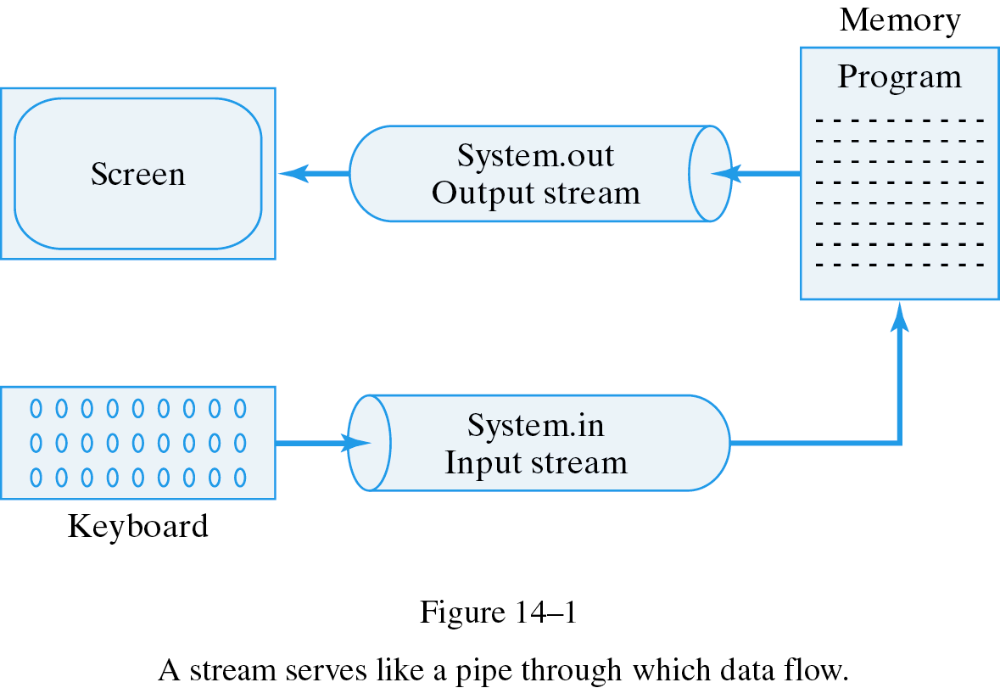
System.out
System.in

Slide 64



What are Streams?
The I/O System in Java is based on Streams
  Input Streams are data sources
    Programmers read data from input streams
  Output Streams are data sinks
    Programmers write data to output streams
Java has two main types of Streams
  Byte Oriented
    Each datum is a byte
    uses InputStream class hierarchy & OutputStream class hierarchy
  Character-based I/O streams
    each datum is a Unicode character
    uses Reader & Writer class hierarchy

Slide 65
Byte-Oriented Input Stream Classes
InputStream
ByteArrayInputStream
FileInputStream
SequenceInputStream
ObjectInputStream
PipedInputStream
FilterInputStream
BufferedInputStream
DataInputStream
PushbackInputStream
Decorators
ZipInputStream
ZipInputStream is defined in: java.util.zip

Slide 66
Character-Oriented Stream Classes
Object
InputStream
Reader
OutputStream
Writer
<<abstract>>
Reader
<<abstract>>
Writer
FileReader
BufferedReader
FileWriter
BufferedWriter

Slide 67
Creating an InputStream
InputStream is an abstract class
  Programmers can only instantiate subclasses.
ByteArrayInputStream:
  Constructor is provided with a byte array.
  This byte array contains all the bytes provided by this stream
FileInputStream:
  Constructor takes a filename or a FileDescriptor Object.
  Opens a stream to a file.
FilterInputStream:
  Provides a basis for filtered input streams
  Our focus…

Slide 68

Creating an InputStream
ObjectInputStream
  Created from another input stream (such as FileInputStream)
  Reads bytes from the stream (which represent serialized Objects) and converts them back into Objects
PipedInputStream:
  Connects to an Instance of PipedOutputStream
  A pipe represents a one-way stream through which 2 threads may communicate
    Thread1 writes to a PipedOutputStream
    Thread2 reads from the PipedInputStream
SequenceInputStream:
  Constructor takes multiple InputStreams
  Allows reading. When one stream ends, it continues reading from next stream in the list

Slide 69



Slide 70

Decorator Pattern in Java
System.in is associated with keyboard input stream
  ... InputStreamReader: Reads bytes and translates them into characters using the specified character encoding.
BufferedReader
  Read text from a character-input stream, buffering characters so as to provide for efficient reading of characters, arrays, and lines.
Example:
  BufferedReader keyboard = new BufferedReader(new InputStreamReader(System.in));

Slide 71

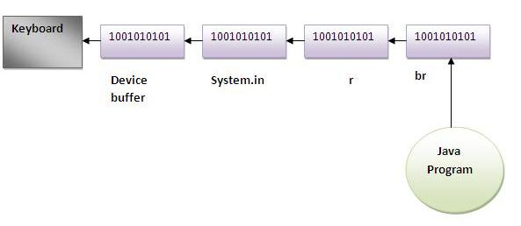
import java.io.*;
class Test{
public static void main(String args[])throws Exception{
InputStreamReader r=new
InputStreamReader(System.in);
BufferedReader br=new BufferedReader(r);
System.out.println("Enter your name");
String name=br.readLine();
System.out.println("Welcome "+name);
}
}

Slide 72

Example of decorator pattern use
BufferedReader decorates InputStreamReader
BufferedReader
readLine()
InputStreamReader
read() close()

Slide 73

I/O Explanation
Normal InputStream class has only public int read() method to read one letter at a time
Decorators such as BufferedReader add functionality to read the stream more easily
  // InputStreamReader/BufferedReader decorate InputStream
  InputStream in = new FileInputStream("hardcode.txt");
  InputStreamReader isr = new InputStreamReader(in);
  BufferedReader br = new BufferedReader(isr);
  // Thanks to decorator streams, can read an
  // entire line from the file in one call else would read characters
  // (InputStream only provides public int read() )
  String wholeLine = br.readLine();

Slide 74
Filter Output Streams - Example
import java.io.*;
public class MyClass{
public void test() {
try {
FileOutputStream out = new FileOutputStream("Test");
OutputStreamWriter oswOut = new OutputStreamWriter(out);
BufferedWriter bufOut = new BufferedWriter(oswOut);
// programmer now uses bufOut…
}
catch (IOException x){
}
}
}
bufOut
oswOut
out
Programmer
Writes
Data
BufferedWriter
OutputStreamWriter
FileOutputStream
File
named
"Test"
Data Buffered in
BufferedWriter
Character Data converted
to byte data
Byte Data written to file

